Slide 1
Horticulture 203- Floral Design Portfolio
By: Joshua Johnson

Slide 2
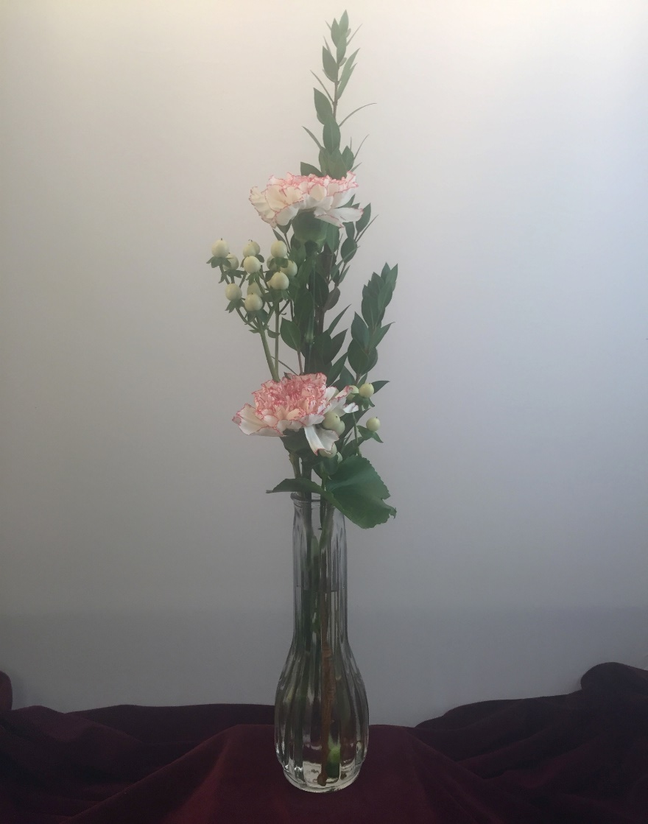
Bud vase- Aug. 30th
1 Myrtle
2 Carnations
2 Hypericum
2 Galax

Slide 3
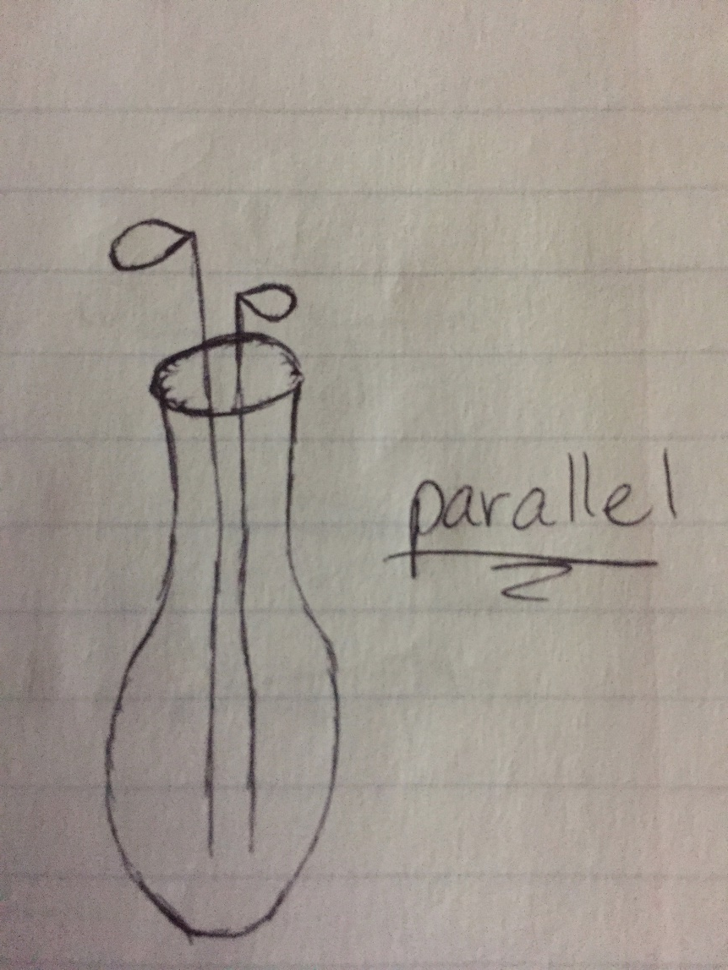
Bud Vase-Line Drawing

Slide 4
Bud Vase-
Element of Design
Line- Visual path the eye follows to produce motion.
Line is well done is this design by having many strong vertical lines as well as the on top of the other placement of the carnations.

Slide 5
Bud Vase-
Principle of Design
Proportion- Relationship of each component of the design to each other in size, shape, quality, form and the environment.
Proportion is done well in this design by accomplishing the golden proportion rule of being one and a half times the size of the container.

Slide 6
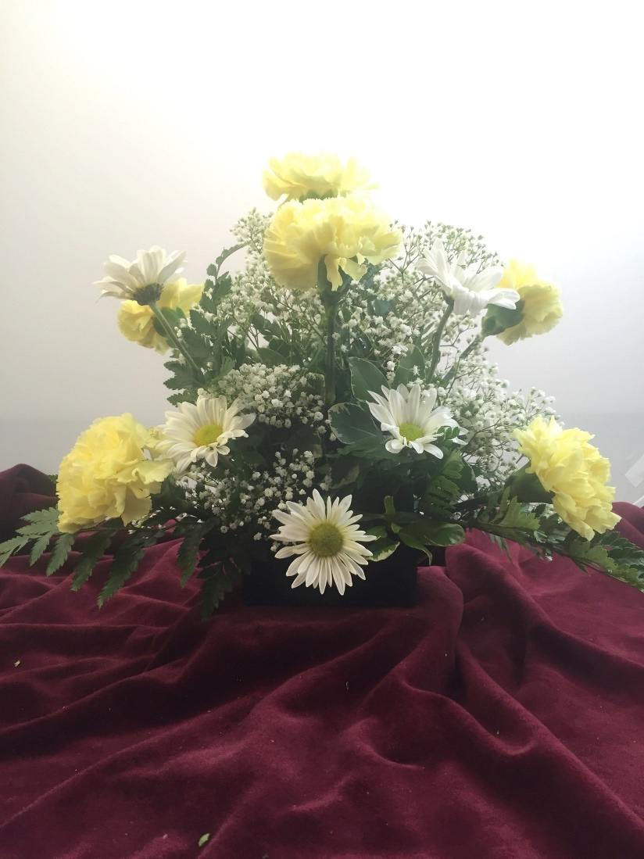
Small Round- Sept.6th
3 Leather Leaf
7 Carnations
2 Stems Daisy
Chrysanthemum
1 Baby's Breath
1-2 Pittosporum

Slide 7
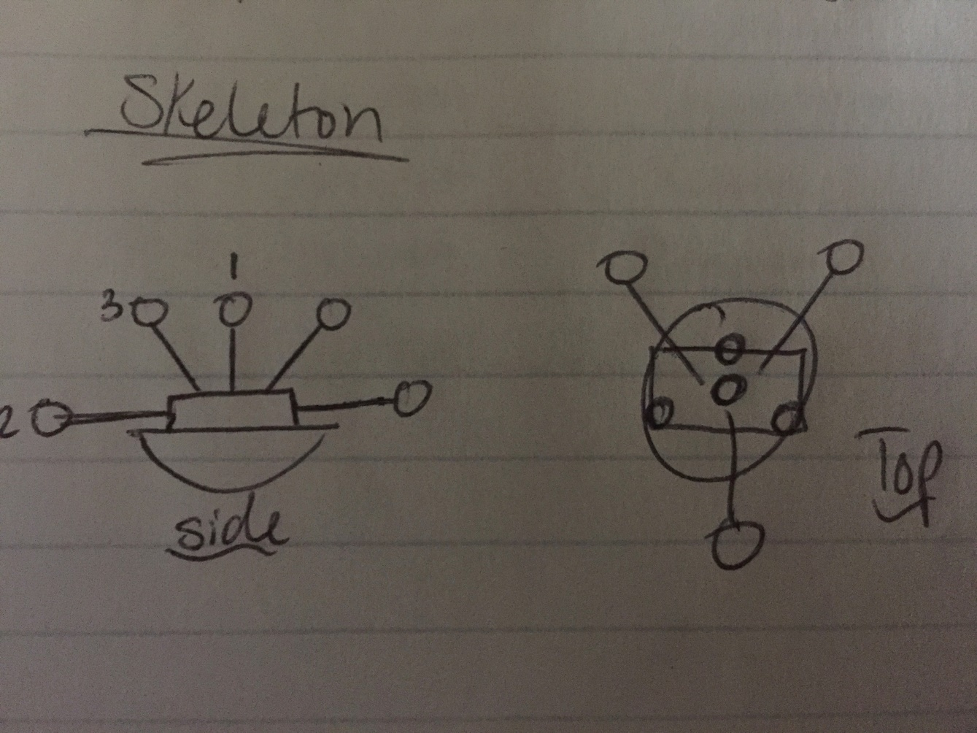
Small Round-
Line Drawing

Slide 8
Small Round-
Element of Design
Form- The shape or contour of the individual components in a composition and/or the overall shape or configuration of a composition.
Form is done well is this design by accomplishing an overall round shape using the materials provided.

Slide 9
Small Round-
Principle of Design
Unity- Oneness of purpose, thought, style and spirit to accomplish a cohesive relationship of individual parts.
Unity is done well in this design by just creating this feeling that all these flowers go together as a whole to complete the round shape.

Slide 10
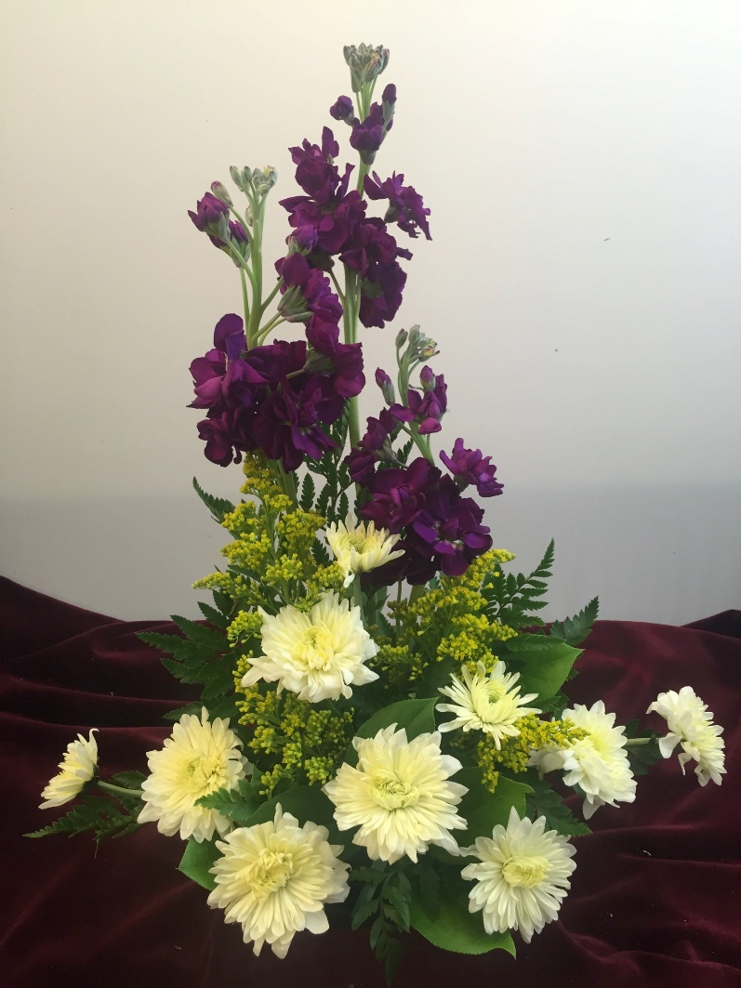
Symmetrical Triangle- Sept.13th
3 Stock
1 Solidago
2 Cushion
Chrysanthemum
2 Salal
3-4 Leather leaf
1 Pittosporum

Slide 11
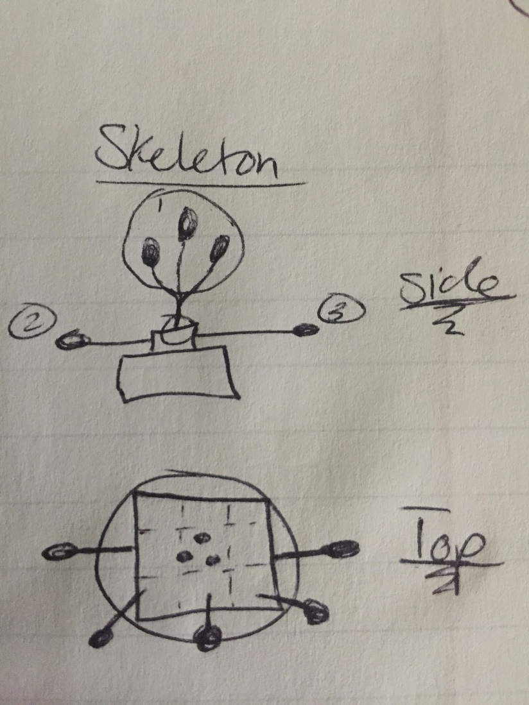
Symmetrical Triangle- Line Drawing

Slide 12
Symmetrical Triangle- Element of Design
Line- Visual path the eye follows to produce motion.
Line is done well in this design by a combination of strong vertical and horizontal lines. Also the placement of the Cushion mums really bring out the line element in the design.

Slide 13
Symmetrical Triangle- Principle of Design
Balance- Components of design that are placed on either side to feel stability and security.
Balance is done well in this design by accomplishing symmetrical design. Making the whole design feel like it is completely balanced in color and number of flowers.

Slide 14
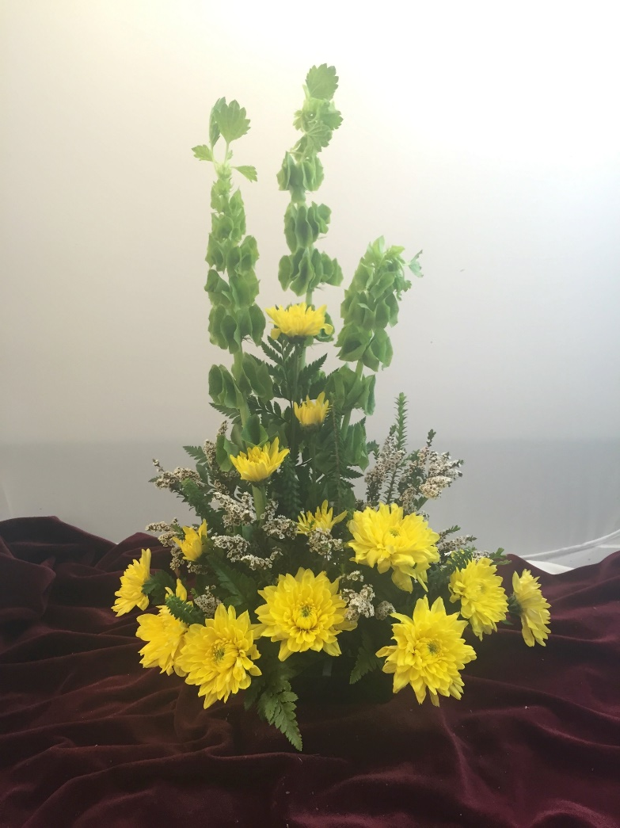
Asymmetrical Triangle- Sept. 20th
3 Bells of Ireland
2 Cushion
Chrysanthemum
2 Honey Melaleuca
2 Leather Leaf
1 Calcynia

Slide 15
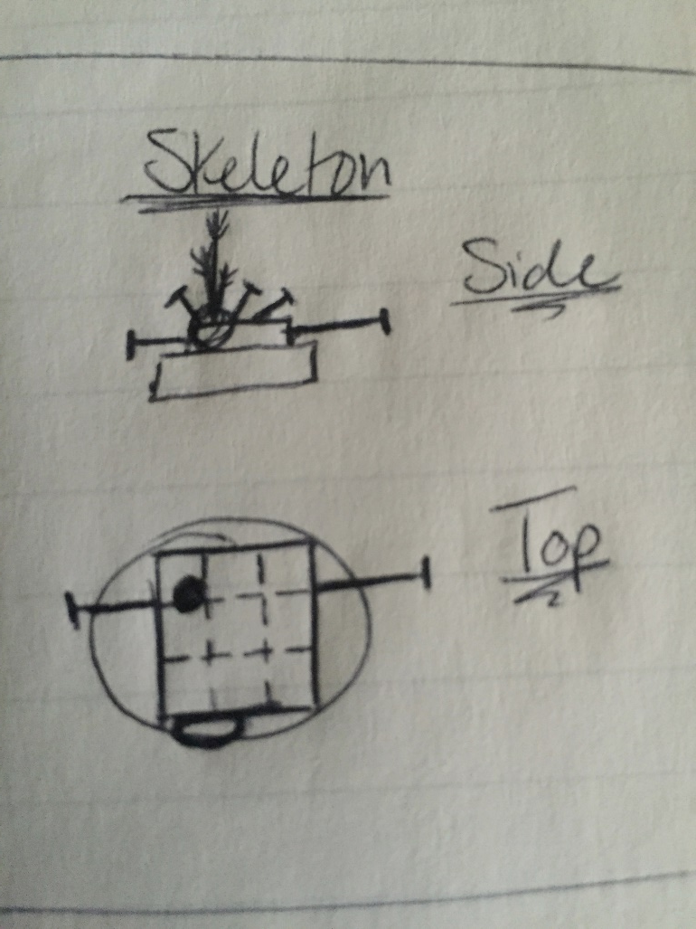
Asymmetrical Triangle- Line Drawing

Slide 16
Asymmetrical Triangle- Element of Design
Line- Visual path the eye follows to produce motion.
Line is done well in this design by using vertical and horizontal lines. The sequential placement of the Cushion mums also adds a strong line element to the design.

Slide 17
Asymmetrical Triangle- Principle of Design
Balance- Components of design that are placed on either side to feel stability and security.
Balance is done well in this design by accomplishing asymmetrical balance by leaving on Cushion mum on the right side longer than the one of the left side. Really bringing out the asymmetrical feel in the design.

Slide 18
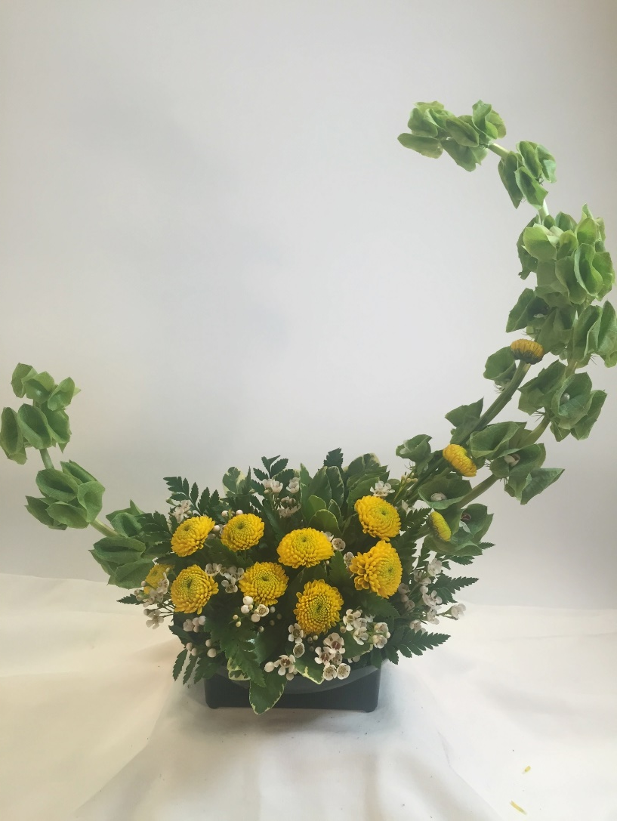
Crescent- Sept. 27th
3 Belles of Ireland
2 Button
Chrysanthemum
1 Waxflower
4 Leatherleaf
2 Pittosporum

Slide 19
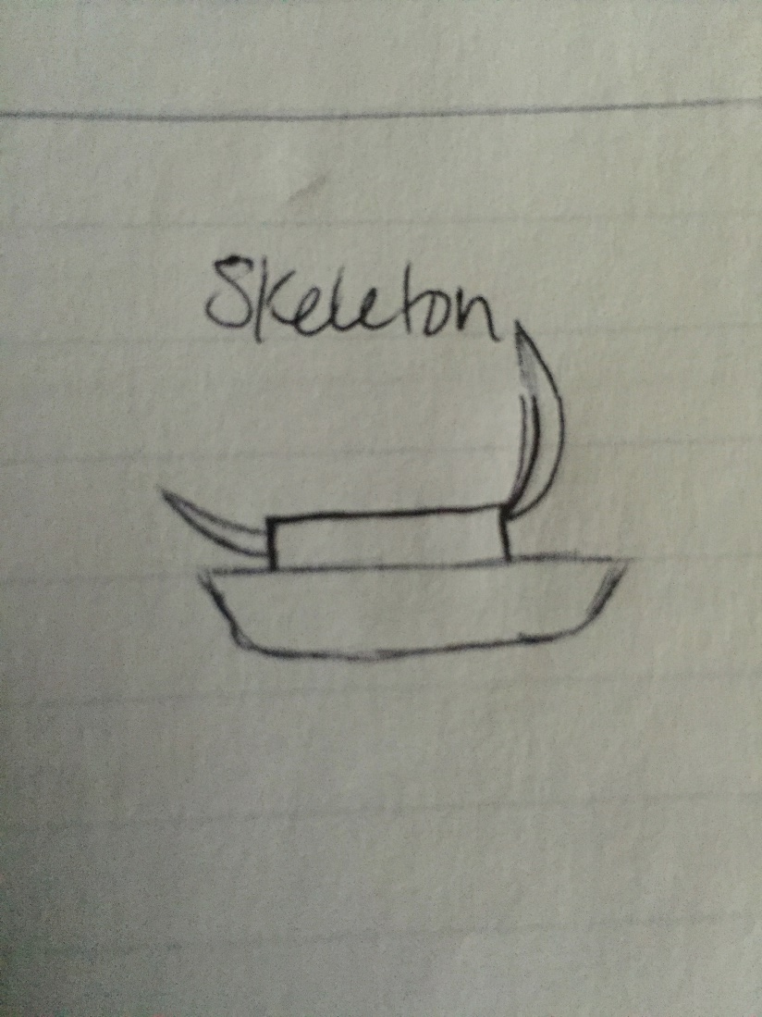
Crescent- Line drawing

Slide 20
Crescent-
Element of Design
Space- The open areas around the individual components as well as the areas occupied by the composition.
Space is done well in this design by creating a lot of negative space using the Bells of Ireland. After realizing all the negative space you next look to the great looking positive space the flowers produce.

Slide 21
Crescent-
Principle of Design
Rhythm- The related orderly motion of lines, forms, shapes, or spaces of a design.
Rhythm is done well in this design by having a great fluid motion from one tip of the Bells of Ireland through the base flowers to the other tip. Your eye never feels the need to stop so rhythm is done well.

Slide 22
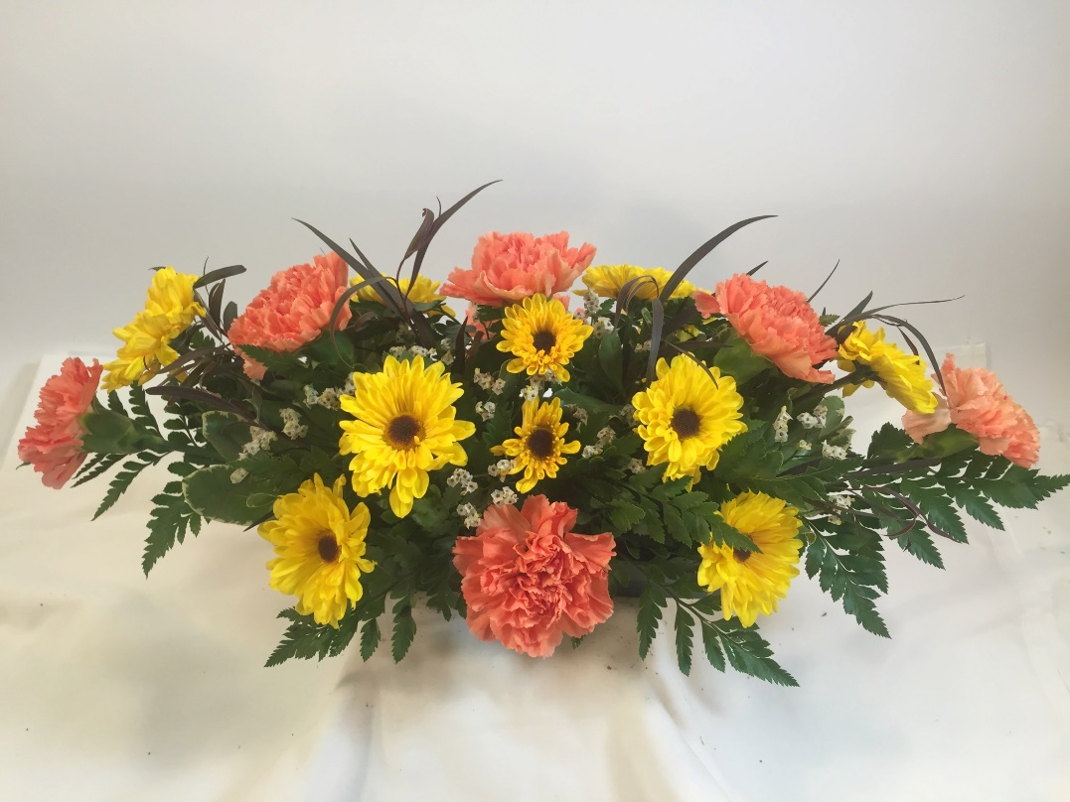
Horizontal- Oct.4th
7 Carnation
2 Agonis
2 Viking
Chrysanthemum
1 Limonium
4 Leatherleaf
1 Pittosporum

Slide 23
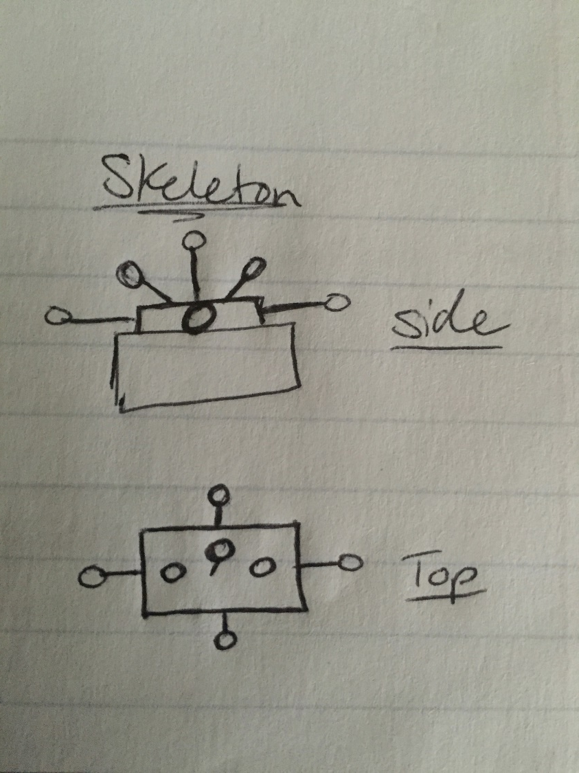
Horizontal- Line Drawing

Slide 24
Horizontal-
Element of Design
Line- Visual path the eye follows to produce motion.
Line is done well in this design by many horizontal, vertical and diagonal lines. The sequential placement of the Viking mum and Carnations do a great good of creating these lines.

Slide 25
Horizontal-
Principle Of Design
Harmony- The personal pleasing relationship that exist between various units or components of the design to make a whole composition.
Harmony is done well in this design because I personal love the rectangular shape and placement of the flowers to create such great line. I really enjoy looking at this design and was the arrangement I gave away as my Service Learning Project.

Slide 26
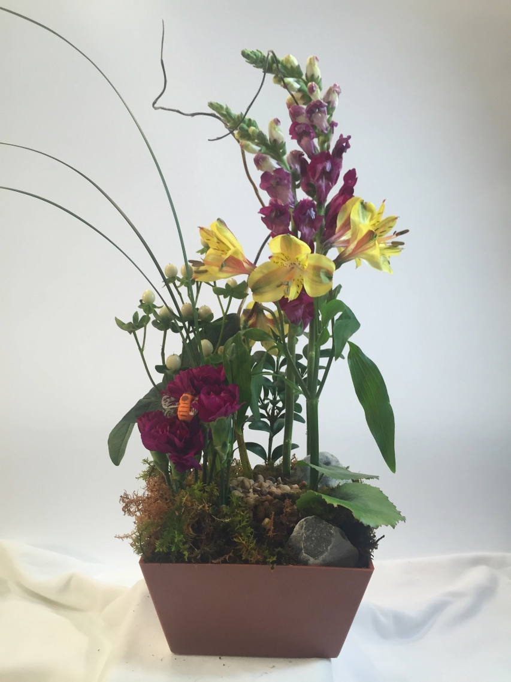
Vegetative-Oct. 11th
2 Snapdragons
2 Hypericum
1 Pixie Carnations
1 Alstroemeria
5 Honey Melaleuca
½ Boxwood
3 Lily Grass
3 Galax

Slide 27
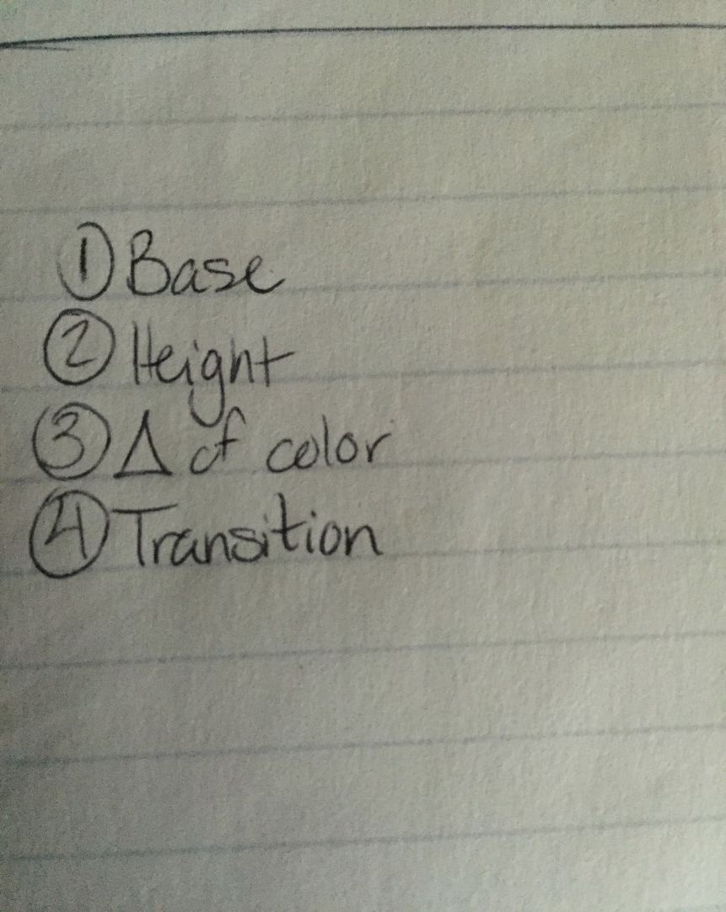
Vegetative-Line Drawing
TA said line drawing was not needed but to include this!

Slide 28
Vegetative-
Element of Design
Texture- Physical surface quality of materials and overall “feel” of the design.
Texture is done well in this design by using many different flowers with different surface textures. The design also gives off a overall feel of a garden-like appearance that is conveyed very well by grouping of same flowers.

Slide 29
Vegetative-
Principle of Design
Contrast- Difference between objects when they are placed next to each other.
Contrast in done well in this design by providing color and texture variation throughout the design. Making the viewer really delved into the design and enjoy every piece of it.

Slide 30
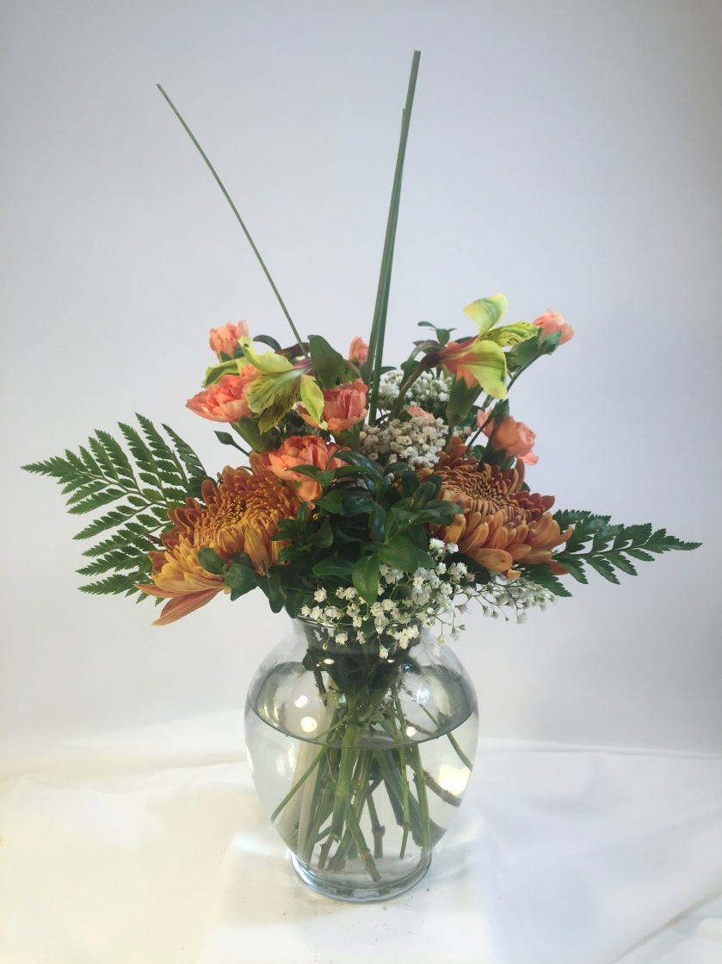
Loose Vase- Nov. 8th
½ Boxwood
3 Leatherleaf
3 Chrysanthemum
3 Pixie Carnations
1 Alstroemeria
½ Baby’s Breath

Slide 31
Loose Vase- Line Drawing
TA said this was not needed due to the fact that it was a design that you had free range to arrange yourself.

Slide 32
Loose Vase-
Element of Design
Form- The shape or contour of the individual components in a composition and/or the overall shape or configuration of a composition.
Form is done well in this design by it accomplishing an overall round shape. Also the design has the mass form of the Football mums at the bottom to not take away from the rest of the arrangement.

Slide 33
Loose Vase-
Principle of Design
Harmony- The personal pleasing relationship that exist between various units or components of the design to make a whole composition.
Harmony is done well in this design because the overall color scheme and shape make it very pleasing to look at. This design is personally my favorite because it was so fun create something on your own.

Slide 34
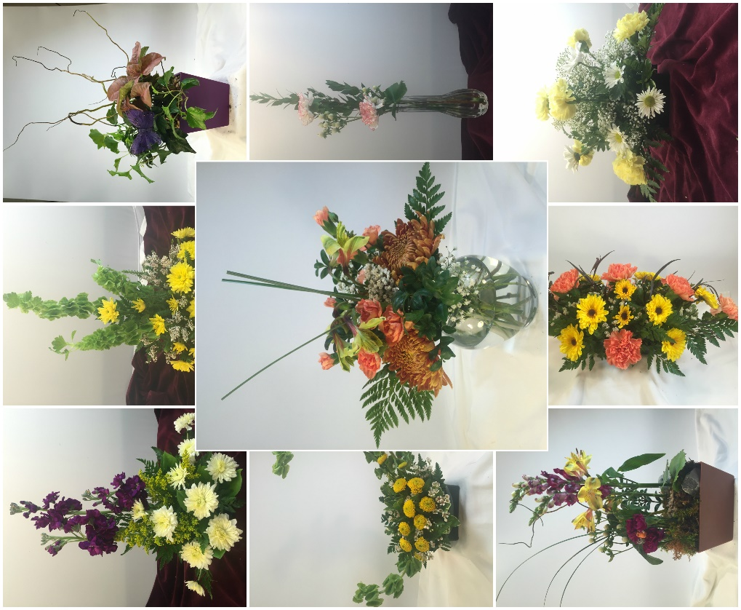
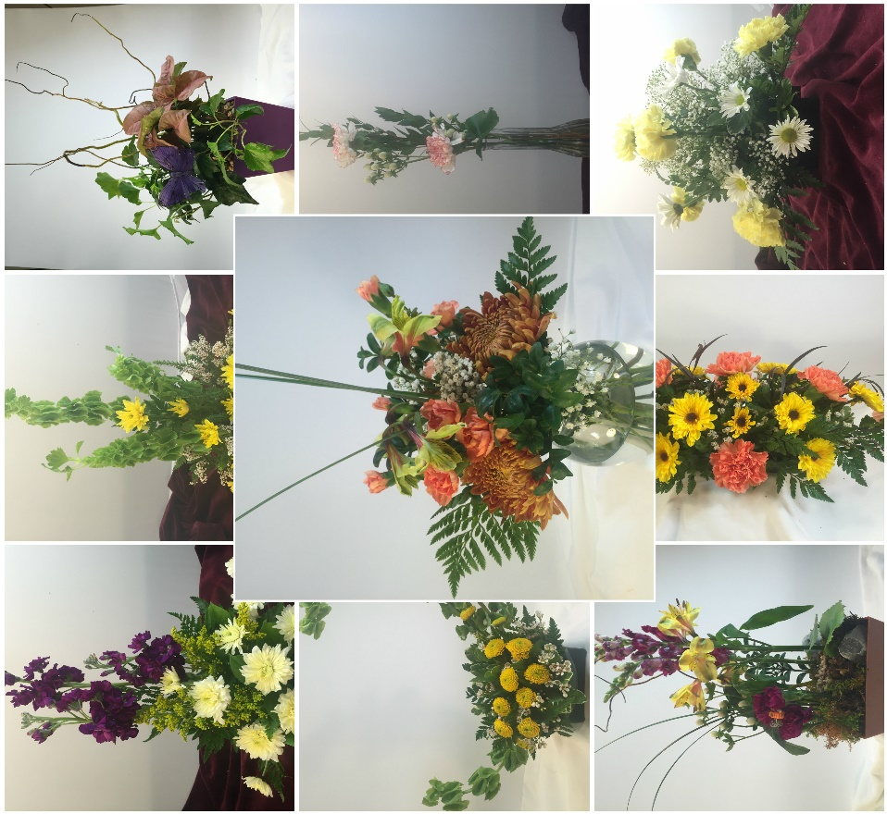
THANK YOU FOR BEING GREAT!!!

