Slide 1
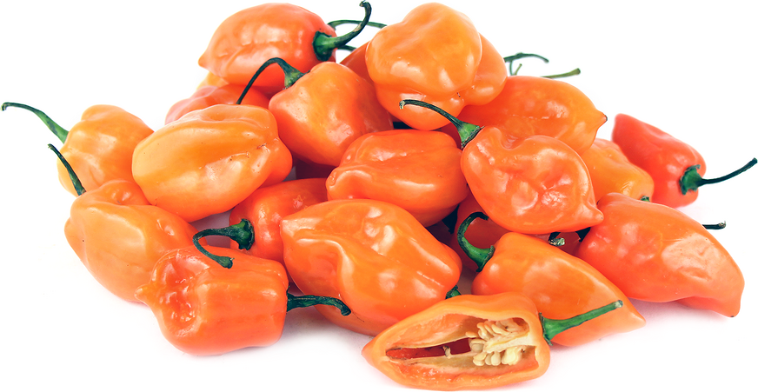
Habanero Pepper: Have We Found the Unknown Cure?
Secrets of Capsaicin
BY: Joshua Johnson
Notes:
Image from: http://www.specialtyproduce.com/sppics/820.png

Slide 2
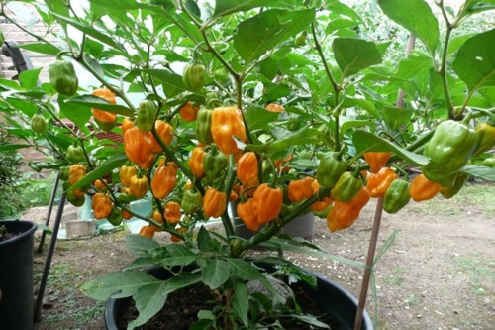
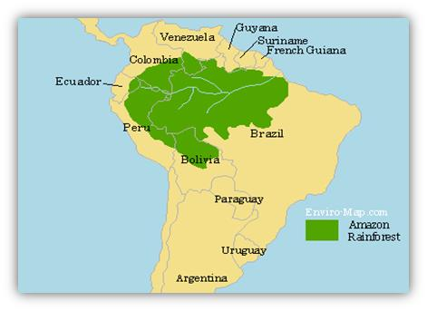
Getting to know the Habanero Pepper
Originated in Amazon Basin, specifically Brazilian
Scientific Name: Capsicum chinense ‘Habanero’
Herbaceous Perennial to Woody shrub
Notes:
Image from: https://static.artfire.com/uploads/product/0/60/28060/8428060/8428060/large/organic_habanero_pepper_30-200_heirloom_seeds_orange_over_40_times_hotter_than_jalapeno__a01d4a3b.jpg
Image from: https://www.peru-explorer.com/rainforest/images/amazon_rainforest.JPG
Originally thought to have originated from China, hence the scientific name but it is now known to have originated from the Amazon rainforest.
In the temperate United States we grow Habaneros as warm season annuals.

Slide 3
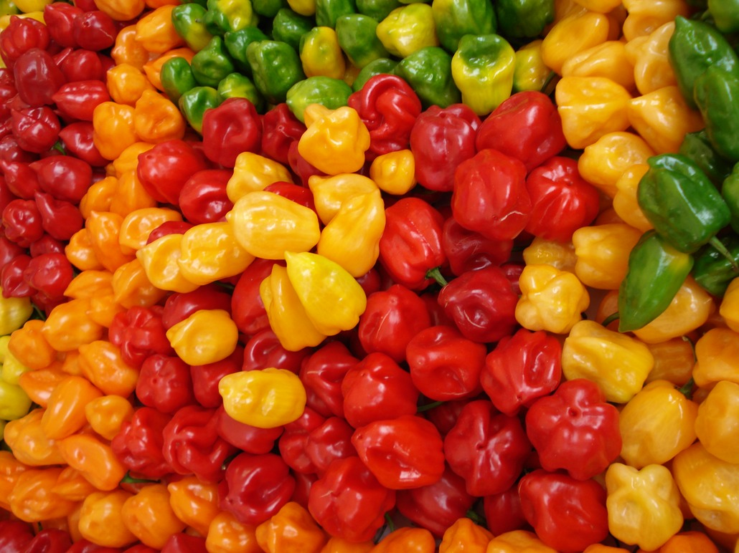
Still Getting to know the Habanero Pepper
Domesticated in South to Central America
Thrives in Tropical environments
Produces hundreds of fruits if optimum climate
Notes:
Image from: http://alkalinevalleyfoods.com/wp-content/uploads/2016/06/Habanero-Pepper.jpg
If grown in the optimum environment the Habanero pepper has been known to produce hundreds of peppers per plant.
Habaneros are still grown and mass produced in Central and South America.

Slide 4
Capsaicin is the Kicker!
Found in every pepper plant
Gives pepper their kick
Known to cause cells to LYSE!
Involved in many medical studies
Notes:
Lyse: destruction or degradation of a cell.
Every pepper in the Capsicum family is known to have capsaicin, either in small or large concentrations.
Capsaicin has been involved in many medical scientific studies that I will go into more detail about later.

Slide 5
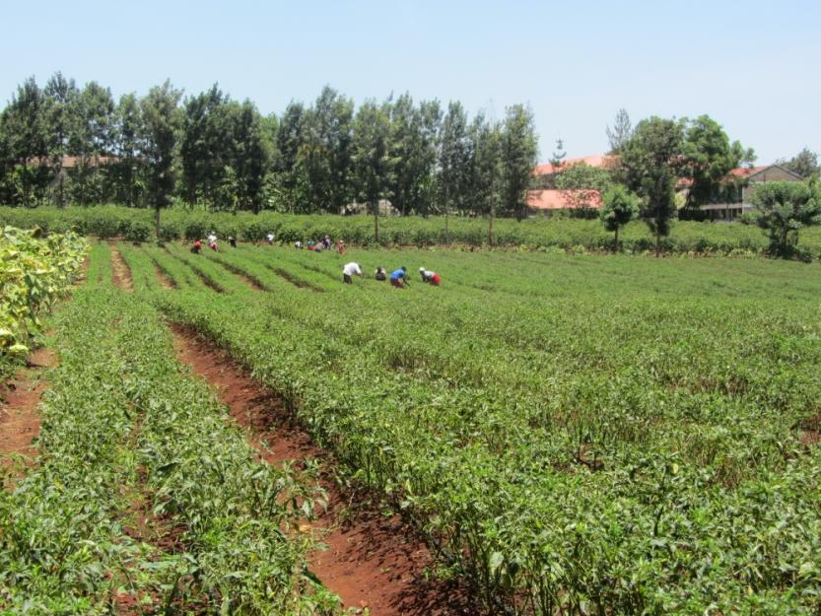
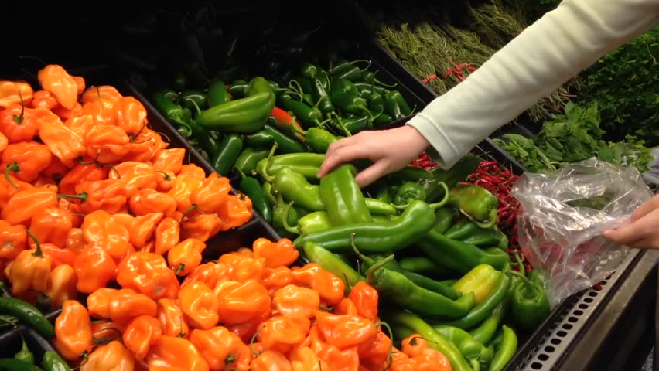
Why Habanero gets Chosen
Massive Production rate
Accessibility and low cost
Notes:
Image from: http://globalsistersreport.org/sites/globalsistersreport.org/files/styles/story/public/stories/images/habanero%20%281000x750%29.jpg?itok=OVl0pnGD
Image from: http://ak6.picdn.net/shutterstock/videos/7864906/thumb/1.jpg
Most of the time Habaneros are chosen due to their easy access, low cost and massive production.
In Mexico there are many large scale Habanero farms that mass produce peppers for the U.S.’s consumption.

Slide 6
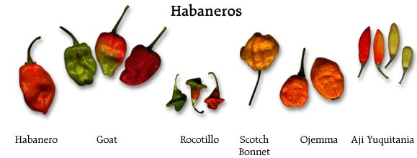
Are Habaneros Special?
Contain a HIGH Capsaicin content
Extensive genetic research completed
Notes:
Image from: http://www.guidetobelize.info/images/habaneros_mixed.jpg
Another reason Habaneros are used is due to the fact that they are the hottest pepper that is mass produced.
Of course there are peppers that are hotter, which means they contain more capsaicin, but they aren’t produced in the quantity that Habaneros are.
Since the peppers have been around so long there has also been a great deal of research on the peppers genetics which aids in scientific uses.

Slide 7
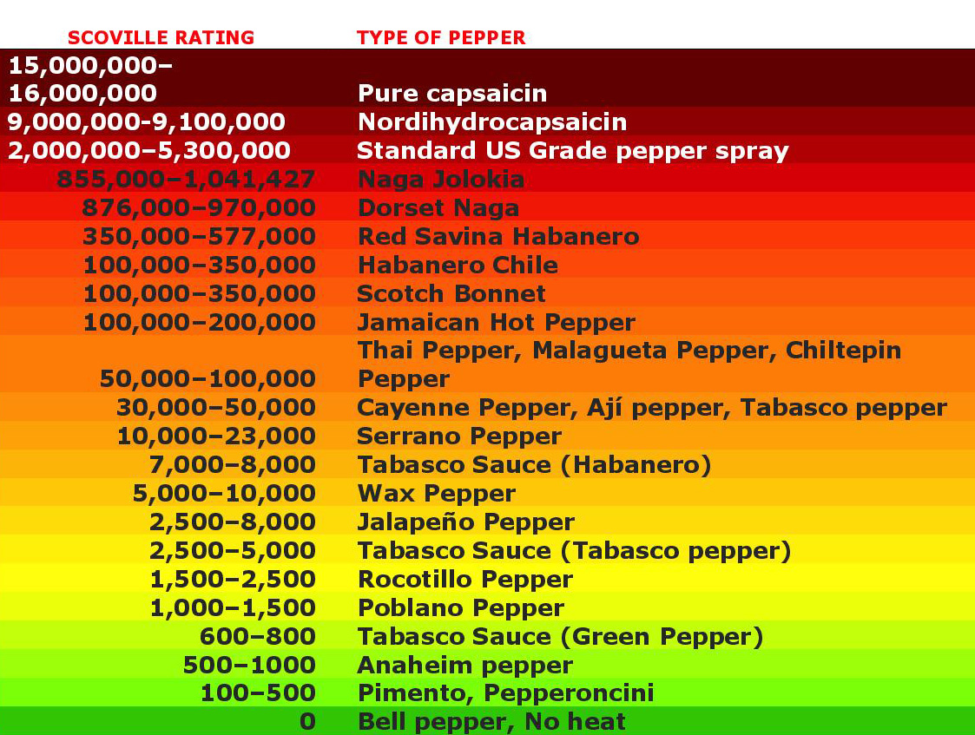
How Habaneros Stack Up
Hotter the pepper
The more Capsaicin
Yes there are hotter peppers
But not mass produced
Notes:
Image from: http://aversiontech.com/products/capsaicins/scale/
As mentioned in the previous slide, you can see here that there are hotter peppers but they are produced in small numbers.
The Super Hot peppers are most produced in home gardens rather than in mass production farms.

Slide 8
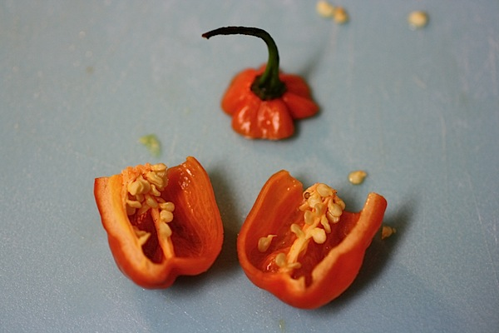
Where is Capsaicin found?
Found in all peppers of Capsicum genus
In the ribs of the pepper
But mostly in the Seeds of the pepper
Notes:
Image from: http://thechiclife.typepad.com/.a/6a00e54fdaec7288340120a622dbb4970c-pi
Many people don’t know but if you take the ribs and seeds out of the pepper then it loses the majority of its spice.
If you cut open any super hot pepper in the Capsicum family and you pay close attention you can sometimes see this clear looking liquid coming from the pepper. This is said to contain some capsaicin along with many other compounds.

Slide 9
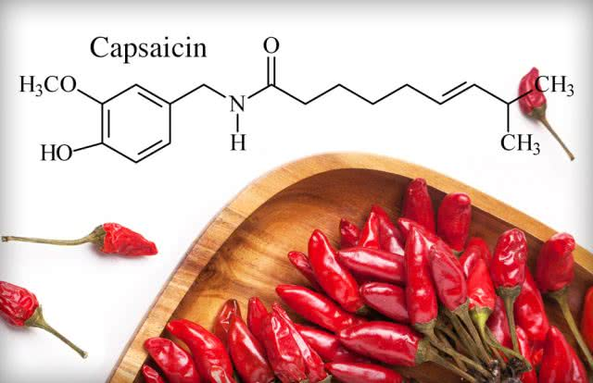
Capsaicinoids
Many different capsaicinoids
Capsaicin is known as the strongest
Notes:
Image from: https://www.cayennediane.com/what-are-capsaicinoids/
There are five naturally occurring capsaicinoids named capsaicin, dihydrocapsaicin, nordihydrocapsaicin, homocapsaicin, and homodihydrocapsaicin.
There is one synthetically produced capsaicinoid that is used to rival capsaicin.
Name of Capsaicin: (6E)-N-[(4-Hydroxy-3-methoxyphenyl)methyl]-8-methylnon-6-enamide

Slide 10
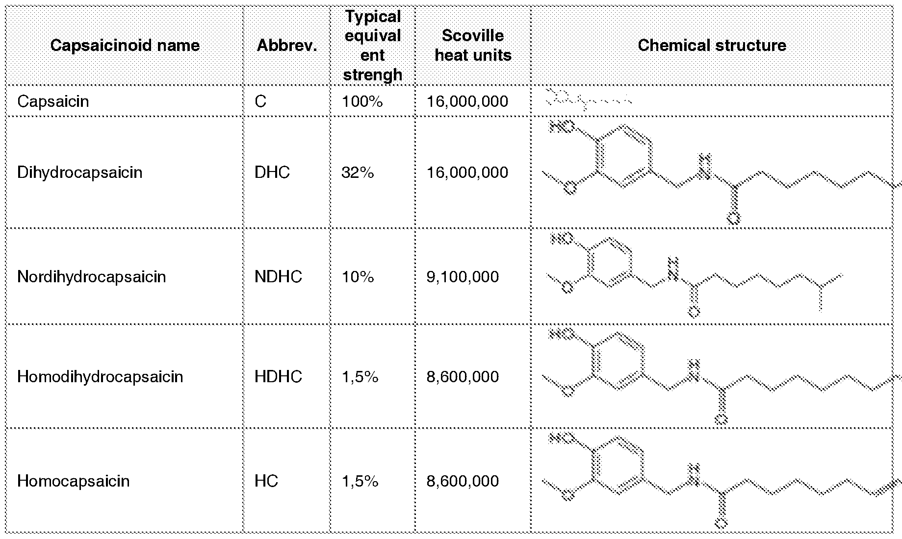
What are Capsaicinoids?
What gives peppers their heat
No flavor
No odor
Attach directly to pain receptors
Notes:
Image from: https://www.google.com/patents/WO2013006135A1?cl=en

Slide 11
Why Scientist Started Using Capsaicin
Known to be an strong irritant
Noticed that animals even avoid contact
Started to use in test trails
Notes:
Everyone knows that you don’t want to come into direct contact with a hot pepper if you aren’t prepared.
Scientist got the idea that if irritated and disrupted our senses and cells so much then it might be useful in the medical field.

Slide 12
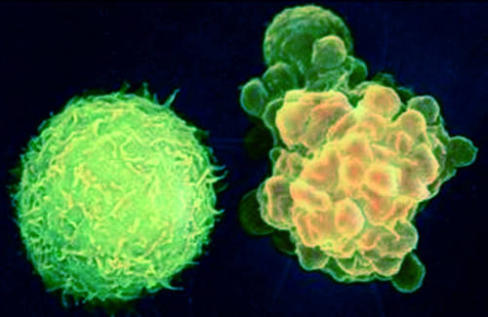
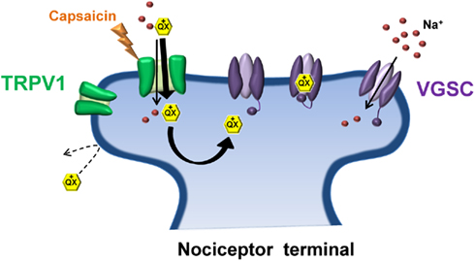
Secrets of Capsaicin
Attaches to TRPV1 receptor on cell membrane
Found to cause apoptosis and lyse in cells
Notes:
Image from: https://i.pinimg.com/originals/ab/bb/31/abbb31a39fff88ca76303067c380741f.jpg
Image from: http://www.nephrology-uni-kiel.com/typo3temp/pics/Apoptosis_02_72ebef437a.jpg
The picture with the two cells is trying to compare a normal and cancerous cell.
Explanation of how capsaicin effects the cell will be explained on the next slide.

Slide 13
How Capsaicin Kills the Cell
After attaching to TRPV1 receptor
Capsaicin causes cells to go into hyper drive
Uses up all its resources and aborts all other processes
Notes:
The way that capsaicin causes the cell to lyse is by attaching to the TRPV1 receptor found on most cells membranes. After it attaches to the receptor it actually stays attached and inhibits anything else from entering or leaving through the TRPV1 pathway. In doing this the cancerous cell keeps dividing and dividing but none of nutrients or compounds needed can enter the cell. The cell is kicked into hyper drive and eventually aborts and kills itself because of the rapid division.

Slide 14
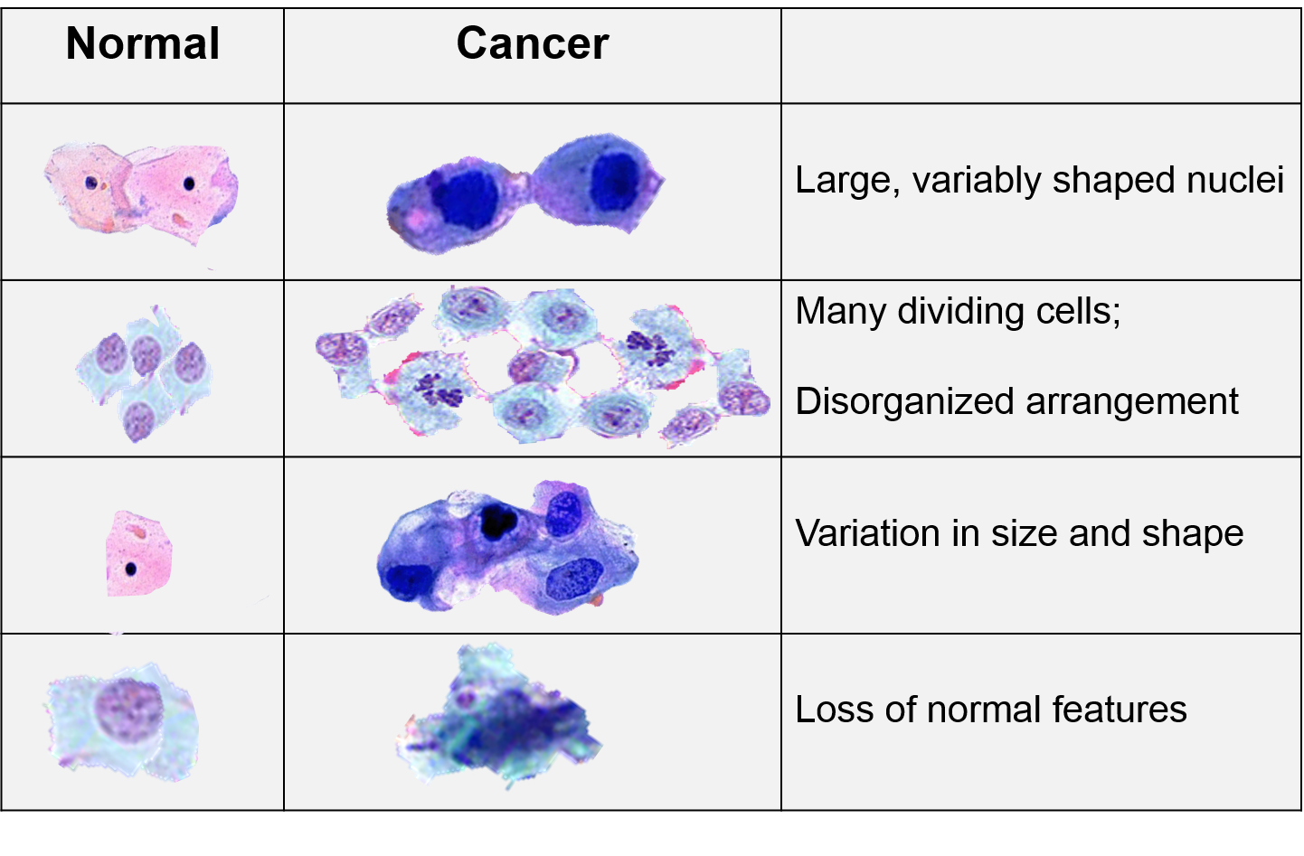
Capsaicin's use in Cancer
Only attacks abnormal cells
Leaves normal cells alone
To be more effective attach Capsaicin to cancer finding compound
Notes:
Image from: http://sphweb.bumc.bu.edu/otlt/mph-modules/ph/ph709_cancer/Characteristics%20of%20Cancer%20Cells.png
In most of the research that I have done it is said that alone capsaicin works well in destroying the cell but if it was used in a human that a compound would be needed to help capsaicin find the unwanted cancerous cells.

Slide 15
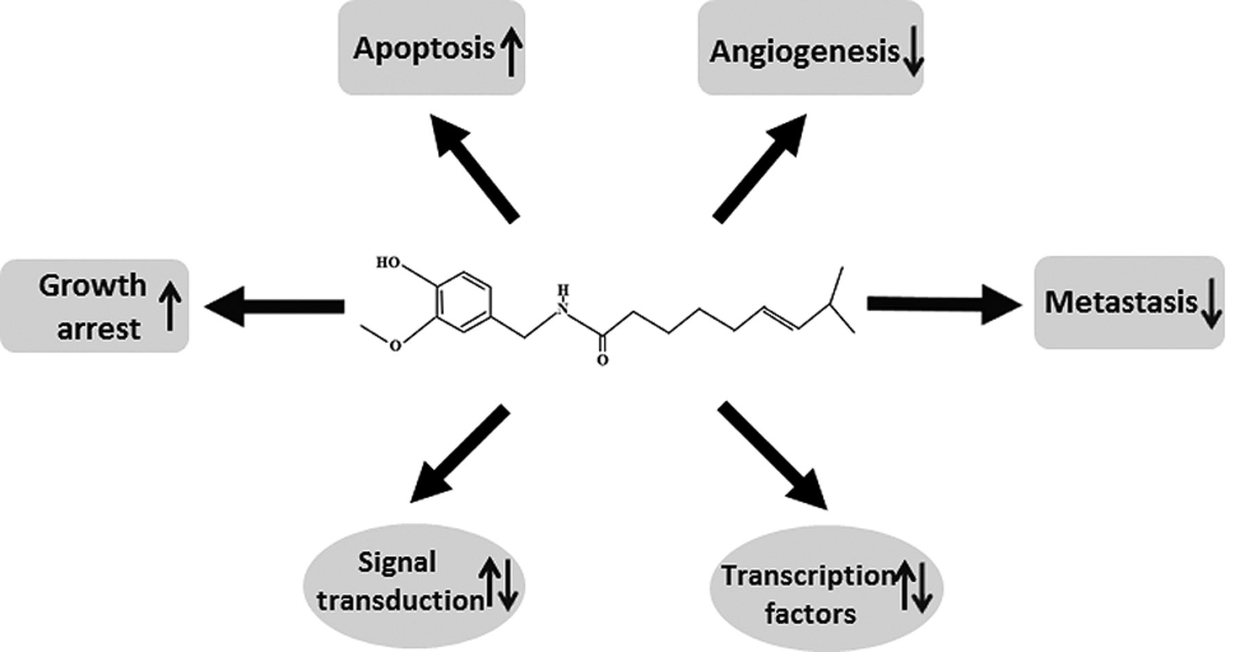
Is Capsaicin the Real Deal?
Many medical scientific studies have been completed
Similarly effective in most studies
Tested on many types of cancer
Notes:
http://ar.iiarjournals.org/content/36/3/837/F1.large.jpg
In every scientific study that I have researched except one, I believe the scientist have said that capsaicin was effective at disrupting the cancerous cells.
Capsaicin has also been test only many different types of cancer from the lung to colon.

Slide 16
Results on Capsaicin Vs. Cancer
No large-scale testing done to date
Results say it is VERY promising
However more research needs to be done to classify as cure
Notes:
Of course since capsaicin hasn’t been test on human cancer at a large scale it cant be labeled a “cure” but many scientist see promise.
Capsaicin combined with other compounds have however been test on dogs with cancer and it decreased the tumors and tumor growth.

Slide 17
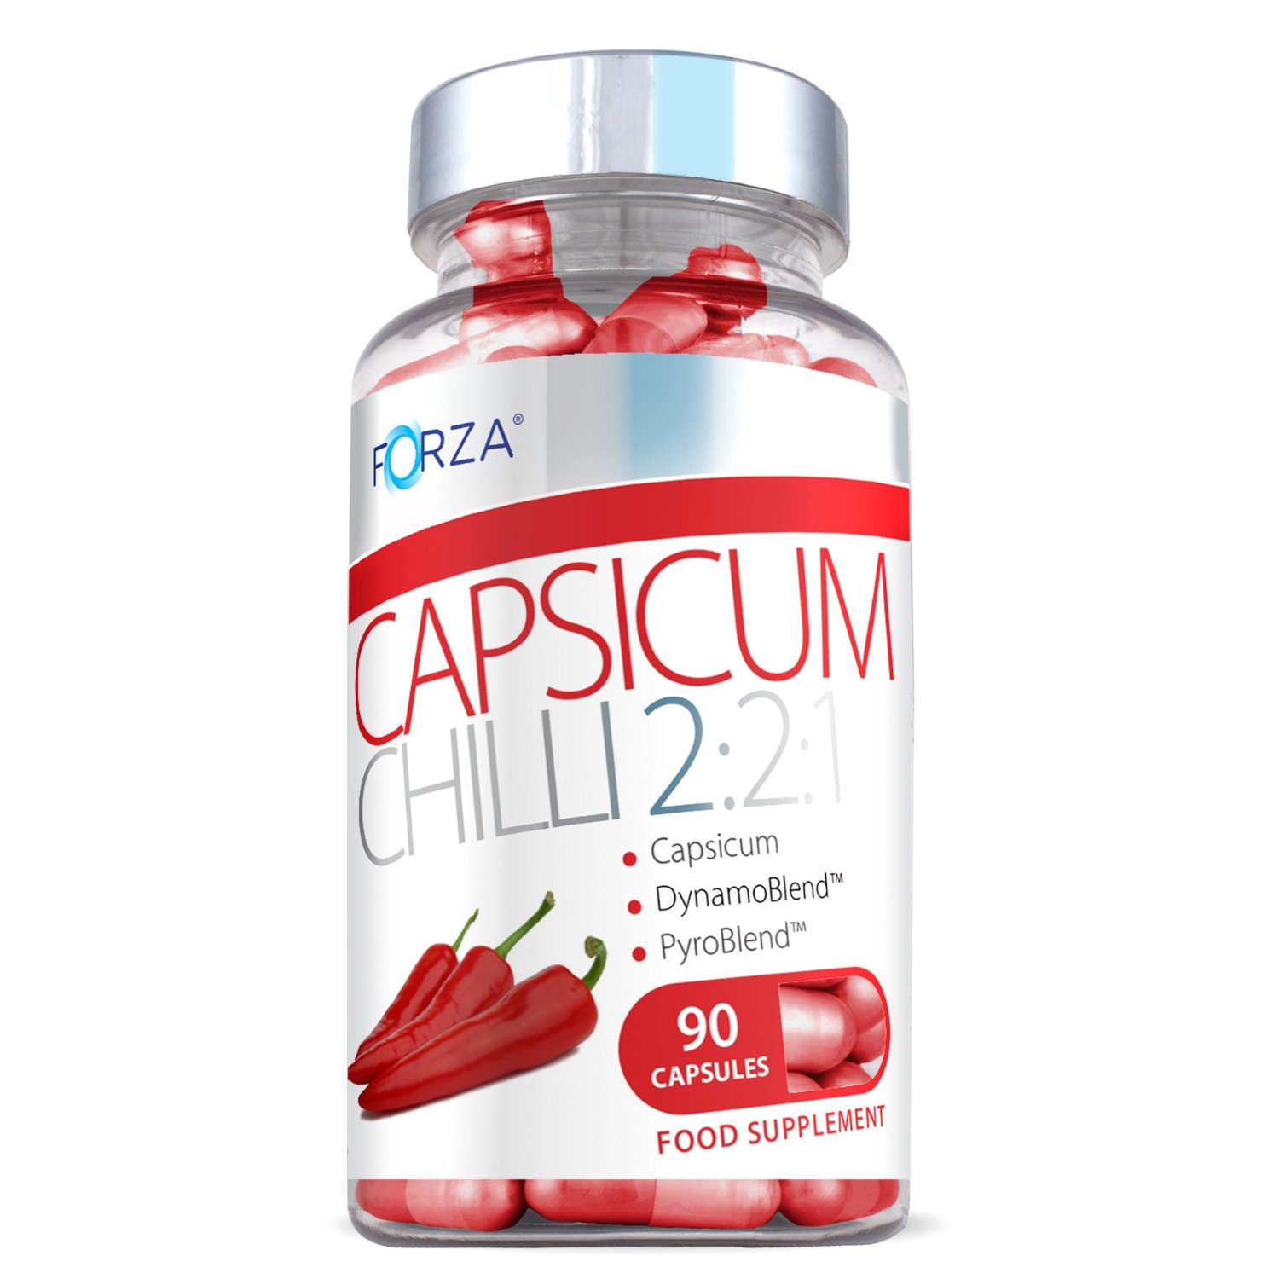
Potential Treatments
Ingesting or injecting isn’t enough
Must actually take by Capsaicin pill and other cancer fighting compounds
Notes:
Image from: https://www.esellersolutions.com/eSellerManager/images/upload/item/wellbeing-pro/product_image_113_5_27_14_13_38.gif
I was surprised to find out that for capsaicin to be effective against cancer scientist said that it couldn’t just be ingested it would have to be by means of other treatment if you wanted to see much improvement in decreasing the amount of cancer growth.

Slide 18
Capsaicin Health Benefits
However, just ingesting can help your health
Capsaicin is known to aid in:
    Weight Loss
    Lowering Blood Pressure
“A Pepper a day can keep the doctor away.”

Slide 19
Overview of Capsaicin
Makes peppers spicy
Found in high concentration in Habanero peppers
Strong Capsaicinoid
Causes apoptosis in cancerous cells
Effective in combination with cancer finding compounds

Slide 20
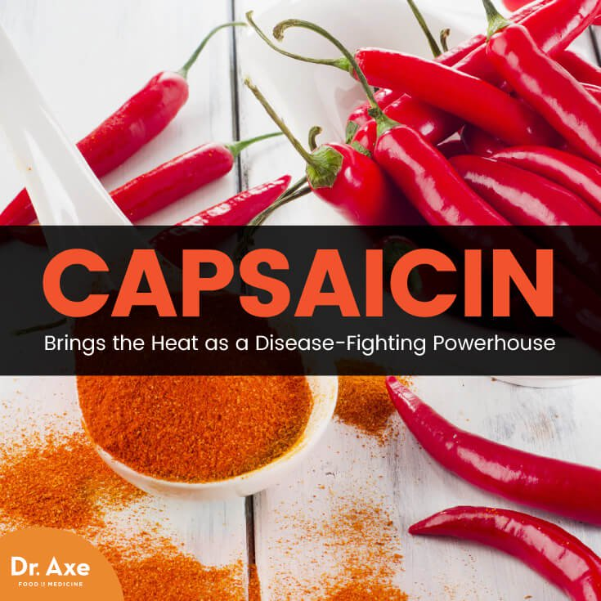
Future of Capsaicin in Cancer Fighting Research?
At this time I see Capsaicin having a great deal of potential
Especially in combination with other cancer fighting drugs
Much needed large-scale testing involving humans
Cancer Fighting Capsaicin!
Notes:
Image from: https://draxe.com/wp-content/uploads/2017/02/Capsaicin-ArticleMeme.jpg
Concluding, I hope to see some large scale testing with capsaicin involving humans in the near future because I can see the great potential that capsaicin could potentially have in the cancer fighting world.
I feel that capsaicin would have to be combined with other cancer fighting and finding compounds to be really effective.

